Slide 1


Slide 2
Clinical Governance
What does it mean to you?

Slide 3
Clinical governance
An umbrella term for an organisational approach to continuous quality improvement of clinical services
Systems and process are in place to ensure the delivery of quality care
Opportunity to improve the health of population prioritising Māori and provide accountability within the organisation
Joining up of all quality improvement initiatives within your organisation

Slide 4









Clinical Governance
Pinnacle Midlands Health Network
Thriving Primary Care
Te Tiriti o Waitangi
Cultural Safety
Kawa Whakaruruhau
Clinically Effective
Clinical Outcomes
Clinical Projects
Clinical Policy
Clinical Decision Making
Evaluation
Safe Patients
Incident Management
Clinical Audits
Risk Management
Accreditation
Great Patient Experience
Patient and Whanau Voice
Stakeholder/Iwi Relationships
Great Provider Experience
Education
Pastoral Care
Joy at Work

Slide 5
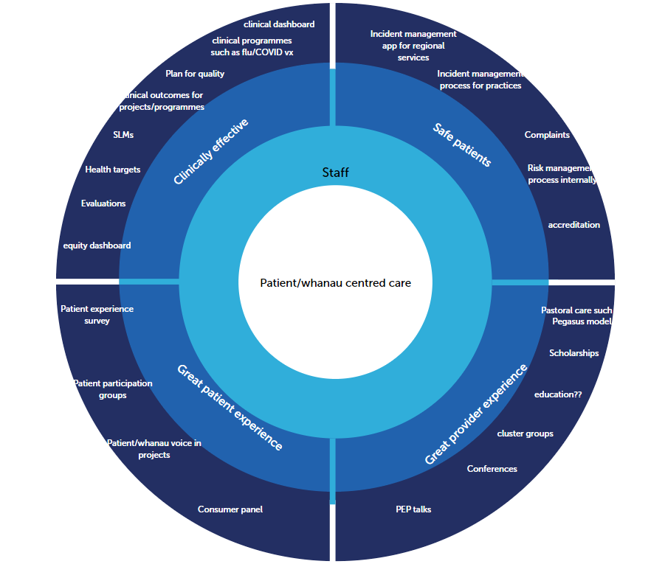

Slide 6

Who is involved in clinical governance for Pinnacle?
A – our directors
B – all clinicians in the organisation
C –all involved in patient/whānau care
D – the clinical governance committee

Slide 7
Why is it important for the organisation?
Important to know
  if our services are making a difference to patients and whānau
  if they are meeting the needs of our patients and whānau
  that all our services are safe
  that what you are doing is improving the health of the population and reducing gaps for the vulnerable

Slide 8



What do you do if you identify risk?
Notes:
Harold Shipman – in 2001 was found guilty of murder of 15 patients – total number of victims thought to be 250
Francis Report 2013 – public inquiry into deaths at Mid Staffordshire HNS foundation trust – unnecessary deaths and why the warning signs of serious failings were not recognised. Recommendations of seeing everything from a patient perspective, transparency, learning culture, accountability.

Slide 9
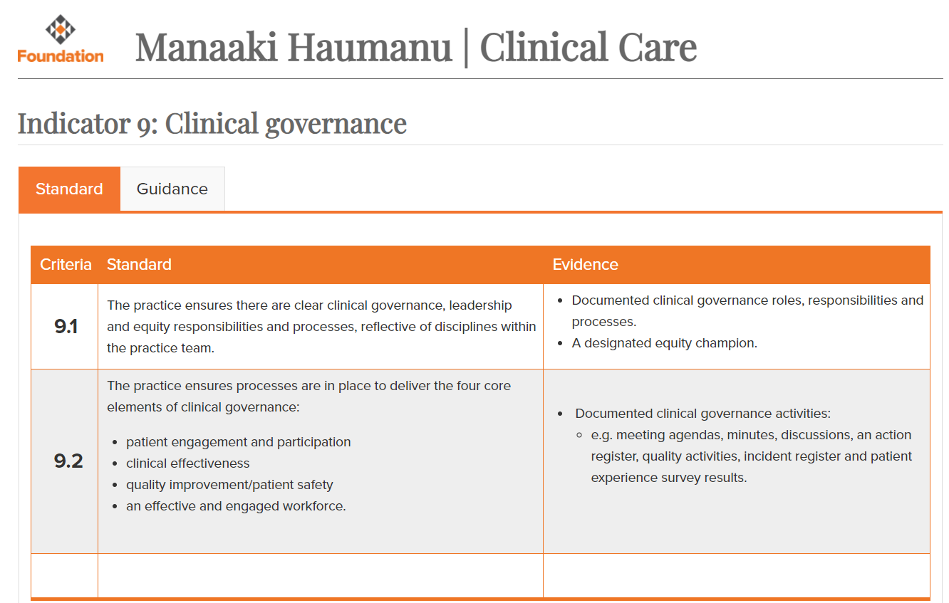

Slide 10
Good sites to explain clinical governance
The RNZCGP https://www.youtube.com/watch?v=ZwDrAEXro3o
HQSC Clinical Governance -guidance for health and disability providers https://www.hqsc.govt.nz/our-programmes/building-leadership-and-capability/publications-and-resources/publication/2851/
AICG Australian Institute of Clinical Governance

Slide 11
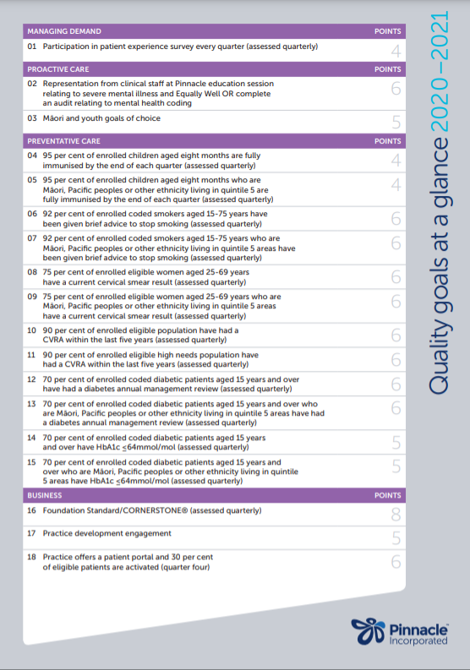

Slide 12
Pinnacle website ....
https://www.pinnaclepractices.co.nz/thriving-practices/quality-plan-2021-2022/

Slide 13
Equity project
“In Aotearoa, people have differences in health that are not only avoidable but unfair and unjust. Equity recognises different people with different levels of advantage require different approaches and resources to get equitable health outcomes.”
- Dr Ashley Bloomfield, Ministry of Health
https://www.pinnaclepractices.co.nz/resources/quality-plan-2021-2022-equity-project/

