Slide 1
Foundation Standards
A focus on health equity: What part do nurses play to influence and support this?

Slide 2
informal discussion
Involvement in the journey- nurse as an influencer, contributor, supporter, teacher,coach
Who has been assessed-experience from a nursing perspective
Pinnacle’s intentional approach to assessment- showcase and tell your story. Informal and validating
Any part of the FS that is unclear
Confidence level relating to equity, diversity, supporting Māori health

Slide 3
Foundation Standards (FS)- Purpose?
The Foundation Standard represents a collection of legislative, regulatory and clinical requirements for all general practices in Aotearoa New Zealand. It represents a nationally consistent benchmark by which a practice can measure its current quality of care and progress toward health equity outcomes.
The Foundation Standard represents quality assurance, which is the first step toward quality improvement and signals to patients the care they will receive meets a baseline for safety and effectiveness.

Slide 4
What part does your nursing team play in the FS quality assurance journey?
Nurses have a connection with almost all 17 indicators:
Code of Health and Disability Services Consumers’ Rights 1996
Patient information
Rights and health needs of Māori
Responsiveness to diversity
Continuity of care
Responsiveness to urgent health needs
Screening and recall
Clinical governance
Prescribing and medicine reconciliation
Controlled drugs
Medical equipment and medicines
Cold chain
Infection control and healthcare waste
Health and safety
Emergency continuity
Employee and contractor safety checking procedures

Slide 5
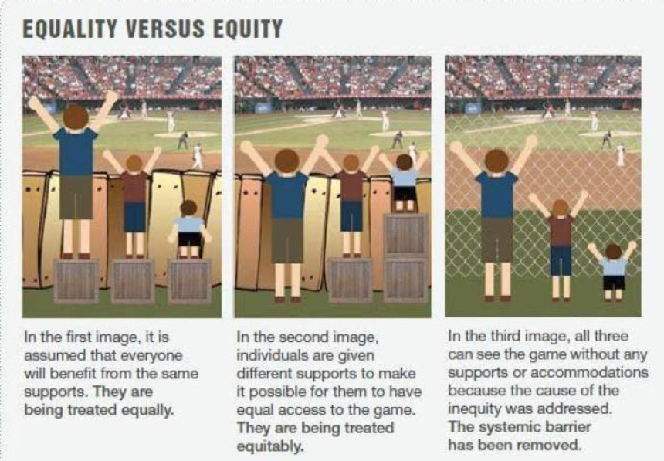
Equality , Equity-thoughts?

Slide 6
Equity definition
In Aotearoa New Zealand, people have differences in health that are not only avoidable but unfair and unjust. Equity recognises different people with different levels of advantage require different approaches and resources to get equitable health outcomes. -Ministry of Health[1]

Slide 7
Indicator 3: Rights and health needs of Māori-what influence are we having or can we have?
3.1 Maori Health Plan
3.2 Te Tiriti o Waitangi
3.3 Using Te Reo Māori

