Slide 1
Growing a diverse nursing workforce to serve a whole population – a locality approach
Sue van Mierlo
Matanga Tapuhi/Nurse practitioner
Pinnacle extended care team

Slide 2
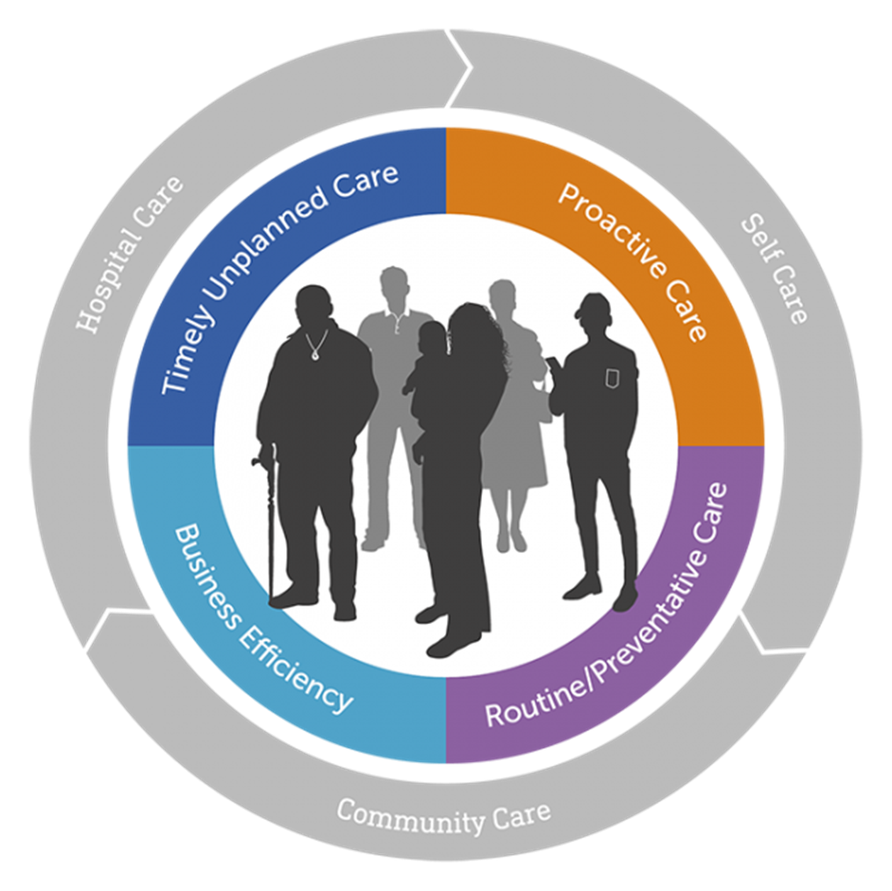
Taupo/Turangi area:
Four ‘health care home’ general practices
Number of nurses completed/completing community prescribing and registered nurse prescribing and on the NP pathway
4 NP’s working in general practice

Slide 3
Aude – registered nurse prescriber, primary health
Aude – registered nurse prescriber, primary health
New role in practice
Mainly working in urgent care clinic and long-term condition follow up
Holistic patient centered care – including whole whanau from birth to old age
Not pressured by time and well supported by GP’s
NZ nursing profession really lucky, compared to France – we are innovative, pushing boundaries with nurses working to the top of their scope, with an equity focus.

Slide 4
Taupo locality extended care team
Clinical manager
Nurse practitioner
dietician
Social worker
Exercise consultants x2
Clinical pharmacist
Peer support worker
Health coaches x2
Access to health improvement practitioners (HIPS)

Slide 5
Clinical support for wider extended care team
Improving access to health care
Equity and improved health outcomes
Population health focus
Innovation
Development of and increasing nursing capacity
Focus on high needs clients/whanau
Extended care team – NP role

Slide 6
Roger, 67 yr old European male
PC: uncontrolled type 2diabetes
HPC diagnosed 2071. HbA1c above target since mid 2017. Current A1c 85 mmol/mol
PMH: Type 2 diabetes
MI
Asthma
hypercholesterolaemia
Meds: Novorapid 12iu with meals
Lantus 20iu bd
Aspirin EC 100mg od
Atorvastatin 80mg od
Gliclazide 80mg bd
Metoprolol 47.5mg od
Quinapril 5mg od
Vildagliptin 50mg bd
Allergies – nil known

Slide 7
FH: unable to recall
Social: Retired
Married, no children
occasional alcohol
Ex smoker
No use of recreational drugs
Labs: A1c 85mmol/mol
normal ACR
normal electrolytes, eGFR 56
Lipids: TC 4.0 mmol/l
Tri 2.5 mmol/l
HDL 0.98 mmol/l
LDL (calculated) 1.9 mmol/l
T/HDL ratio 4.1
CVRA 18%
Obs: BP 128/85
Wt 99kg / BMI 34.9
Retinal screening – R1, M0
ROS: nil

Slide 8
Home visit by Sue – what did I find out?
Doesn’t believe his insulin is working – frustrates him
Eating HUGE amounts of food
Wife is a good cook and culturally a big puku is a sign of wealth
Eventually….
Previous health and issues at former workplace had a big impact
now struggles financially
Some debt that needs dealing with
Socially isolated, no hobbies anymore
TV and food are his best friends

Slide 9
What happened next?
Regular contact by Sue for DM management
Joint appointment with Tracey in primary care
Referral to HIP
Referral to psychologist
Engagement with Exercise coach
Declined dietician – has seen before

Slide 10
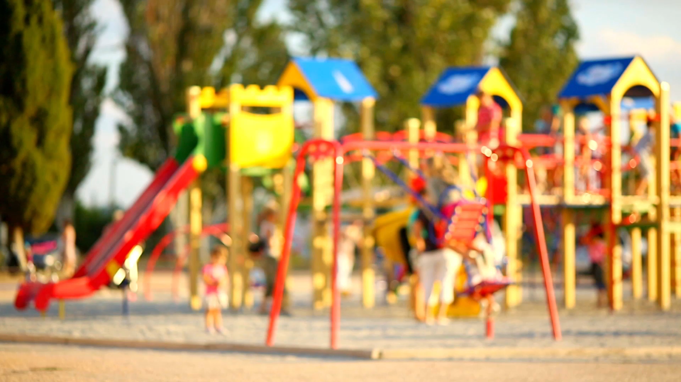
Child health team
Hannah & Pip

Slide 11
Attending clinics at Wai Hina Hub (both hapu mama and child)
Attending clinics at Marae Clinic (both childhood imms and adult flu)
Attending clinics at Awhi House
Offering Home Visits and clinics at Pinnacle Offices (as alternative to GPs in response to both Measles outbreaks and COVID)
CO-joint HVs with other health agencies (eg. THCT, Plunket)
Facilitating enrolment with GP and other health providers.
Both nurses completing community nurse prescribing to enable prescribing of basic medications to otherwise well children within our community who for a variety of reasons may not engage with GP services

Slide 12
Musings
We are all one big team, working together for the benefit of our communities
Use each others' expertise/strengths
Just because you can prescribe, doesn’t mean you have to
Take responsibility for self growth
Look at the bigger picture – not just the disease process
Seek inspiration from the patients you work with to keep doing an amazing job.

